Slide 1
CSE101-Lec 7 Jump statements
break , continue, goto, return

Slide 2
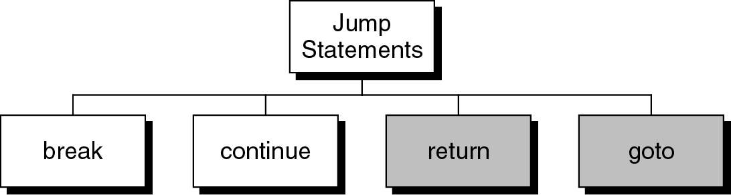
Jump statements
You have learn that, the repetition of a loop is controlled by the loop condition.
C provides another way to control the loop, by using jump statements.
There are four jump statements:

Slide 3
break statement
break is a keyword.
break allows the programmer to terminate the loop.
A break statement causes control to transfer to the first statement after the loop or block.
The break statement can be used in nested loops. If we use break in the innermost loop then the control of the program is terminated only from the innermost loop.

Slide 4
break statement
##include<stdio.h>
int main()
{
int n;
for (n=10; n>0; n=n-1){
if (n<8)
break;
printf(“%d ”, n);
} //end for
}
Program to show use of break statement.
10 9 8

Slide 5
Q1
What will be the output of the following C code?
#include<stdio.h>
int main()
{
int i;
for(i=1;i<=5;i++)
{
if(i==2||i==3)
continue;
printf("\nHello");
}
return 0;
}
A. Hello will be printed 3 times
B. Hello will be printed 5 times
C. Hello will be printed for one time
D. Nothing will be displayed
Notes:
A

Slide 6
Q2
What will be the output of the following C code?
#include<stdio.h>
int main()
{
int i;
for(i=1;i<=5;i++)
{
printf("\nHello");
break;
}
return 0;
}
A. Hello will be printed 4 times
B. Hello will be printed 5 times
C. Hello will be printed for one time
D. Nothing will be displayed
Notes:
c

Slide 7
Q3
//What will be the output of following code?
#include<stdio.h>
int main()
{
int i=0;
while(1)
{
i++;
if(i==2)
continue;
else if(i==5)
break;
printf("%d ",i);
}
return 0;
}
A. 1 3 4
B. 2 5
C. 1 3
D. Nothing will be displayed
Notes:
A

Slide 8
continue statement
continue statement is exactly opposite to break.
continue statement is used for continuing the next iteration of the loop statements
When it occurs in the loop, it does not terminate, but skips the statements after this statement

Slide 9
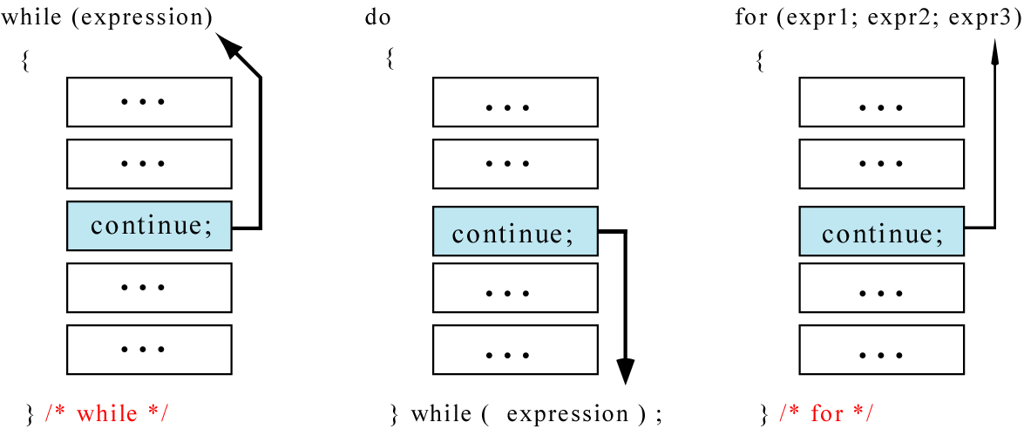
continue statement
In while and do…while loops, the continue statement transfers the control to the loop condition.
In for loop, the continue statement transfers the control to the updating part.

Slide 10
continue statement
#include<stdio.h>
int main()
{
int n;
for (n=10; n>0; n=n-1){
if (n%2==1)
continue;
printf(“%d ”, n);
}
}
Program to show the use of continue statement in for loop
10 8 6 4 2

Slide 11
continue statement
#include<stdio.h>
int main()
{
int n = 10;
while(n>0){
printf(“%d”, n);
if (n%2==1)
continue;
n = n –1;
}
return 0;
}
Program to show the use of continue statement in for loop
For n=9, loop goes to infinite
execution
The loop then prints number 9 over and over again. It never stops.
10 9 9 9 9 9 …………

Slide 12
Q1
What will be the output of the following C code?
#include <stdio.h>
int main()
{
int i = 0;
do
{
i++;
if (i == 2)
continue;
printf("In while loop ");
} while (i < 2);
printf("%d\n", i);
return 0;
}
A. In while loop 2
B. In while loop In while loop 3
C. In while loop 3
D. Infinite loop
Notes:
A

Slide 13
Q2
#include<stdio.h>
int main()
{
int i=1;
while(i<=5)
{
i++;
continue;
printf("\nC");
}
return 0;
}
A. C will be printed 5 times
B. C will be printed 0 times
C. C will be printed 1 time
D. None of these
Notes:
D

Slide 14
Q3
What will be the output of following code?
#include<stdio.h>
int main()
{
int i;
for(i=1;i<=5;i++)
{
printf("%d ",i);
continue;
}
return 0;
}
A. 1 2 3 4 5
B. 1
C. 1 2
D. Nothing will be displayed
Notes:
A

Slide 15
Q4
//What will be the output of following code?
#include<stdio.h>
int main()
{
int i=0;
for(;;)
{
i++;
if(i%3==0)
continue;
else if(i%5==0)
break;
printf("%d ",i);
}
return 0;
}
A. 1 2
B. 1 2 3 4 5
C. 1 2 4
D. Nothing will be displayed
Notes:
c

Slide 16
break vs continue
BASIS FOR COMPARISON | BREAK | CONTINUE
Task | It terminates the execution of remaining iteration of the loop. | It terminates only the current iteration of the loop(or it is used to skip the current iteration and the statements following the continue statement)
Control after break/continue | 'break' resumes the control of the program to the end of loop enclosing that 'break'. | 'continue' resumes the control of the program to the next iteration of that loop enclosing 'continue'.
Causes | It causes early termination of loop. | It causes early execution of the next iteration.
Continuation | 'break' stops the continuation of loop. | 'continue' do not stops the continuation of loop, it only stops the current iteration.
Other uses | 'break' can be used with 'switch', 'label'. | 'continue' can not be executed with 'switch' and 'labels'.

Slide 17
goto
Unconditionally transfer control.
goto may be used for transferring control from one place to another.
The syntax is:
goto identifier;
Control is unconditionally transferred to the location of a local label specified by identifier. For example,
Again:
...
goto Again;

Slide 18
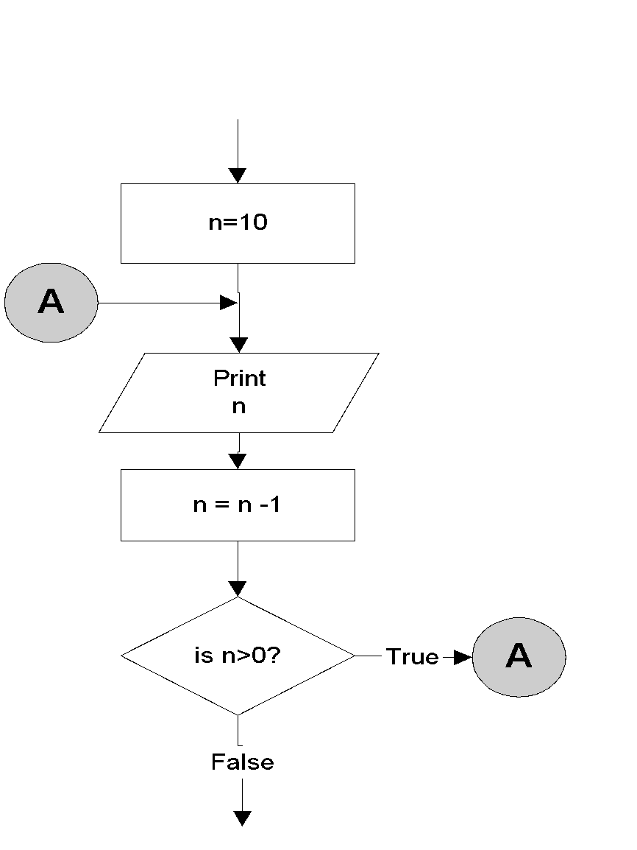
goto statement
n=10;
A:
printf(“%d “, n);
n = n -1;
if (n>0)
goto A;
Output:
10 9 8 7 6 5 4 3 2 1

Slide 19
Program to show goto statement.
#include<stdio.h>
int main()
{
int x;
printf(“enter a number: ”);
scanf(“%d”,&x);
if(x%2==0)
goto even;
else
goto odd;
even:
printf(“ %d is even”, x);
return;
odd:
printf(“%d is odd”, x);
return 0;
}
enter a number: 18
18 is even

Slide 20
return statement
Exits the function.
return exits immediately from the currently executing function to the calling routine, optionally returning a value. The syntax is:
return [expression];
For example,
int sqr (int x){
return (x*x);
}

